Slide 1
SUPER RESOLUTION FOR IMAGES USING MACHINE LEARNING

Slide 2
Group members information
1)KARUN KUMAR BUSSARI – 700734184
2)SAI VENKATA RAVITEJA GURRAPADIYA – 700734672

Slide 3
Role and responsibility of individual members
Karun worked on the coding for loading dataset and also data collection
Required for the project
Ravi worked on identifying the necessary papers for the project implementation also did the documentation work of the project

Slide 4
Motivation
Enlarging or zooming in on an image causes it to distort and blur the details, making it impossible to make out what's going on in the picture.
Goal of this project is to create a system that, given a low-resolution input image, will output a high-resolution version.
User interface through which one may upload a low-resolution image, and receive a super-resolution image.
Download both the original and the expanded version., and rms do not have to be defined.

Slide 5
Objectives
To obtain a crucial component of our product is the clarity of the provided photographs when they are zoomed in or magnified.
Specific objectives
To understand the image pixel value as the original image.
To develop a system that does the scintillation on the image.

Slide 6
Related work
Change detection (CD) is essential to the accurate understanding of land surface changes using available Earth observation data.
Image Super-Resolution (SR) is an important class of image processing techniques to enhance the resolution of images and videos in computer vision. Recent years have witnessed remarkable progress in image super-resolution using deep learning techniques.
image-specific Internal-GAN, which trains solely on the LR test image at test time, and learns its internal distribution of patches. Its Generator is trained to produce a downscaled version of the LR test image, such that its Discriminator cannot distinguish between the patch distribution of the downscaled image and the patch distribution of the original LR image.

Slide 7
Problem Statement
We provide an in-depth analysis of deep learning-based image SR approaches, covering a wide range of topics in the field, from problem settings and benchmark datasets to performance measures, a family of SR methods that incorporates deep learning, domain-specific SR applications, and more.
Overview of the most recent advances in deep learning based SR techniques, summarizing the benefits and drawbacks of each part of an efficient SR solution.
Problems and questions that still need answers, as well as the emerging trends and potential paths forward.

Slide 8
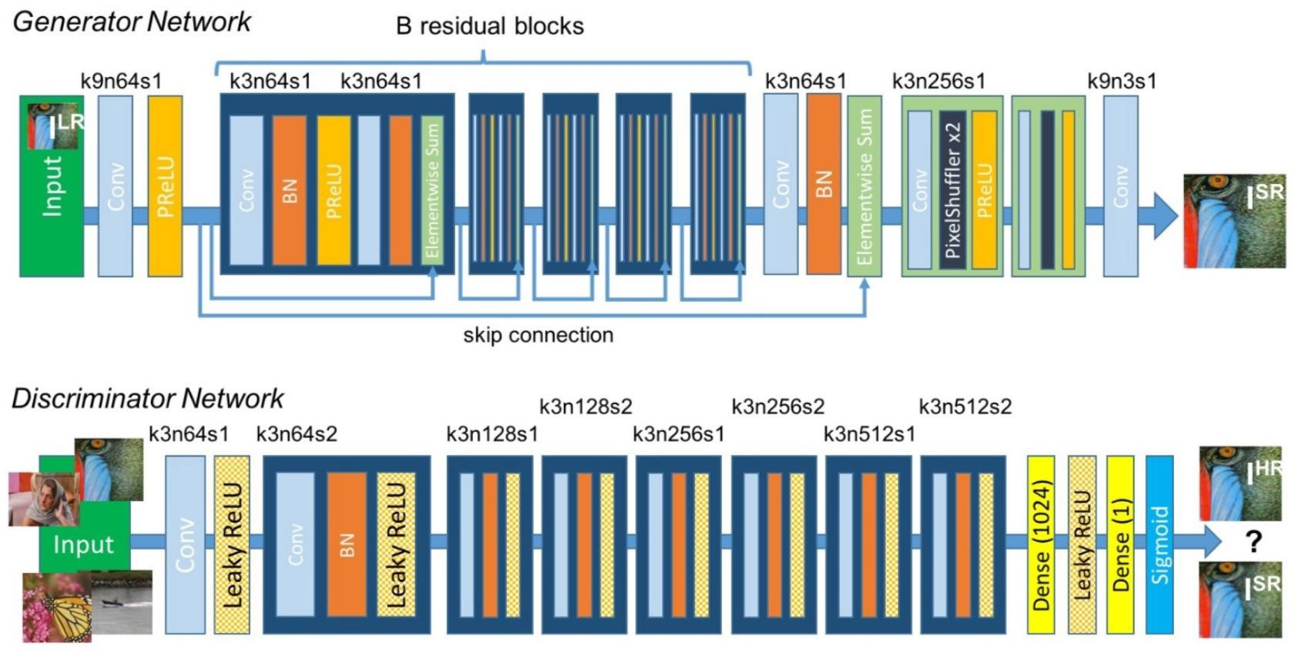
Proposed solution

Slide 9
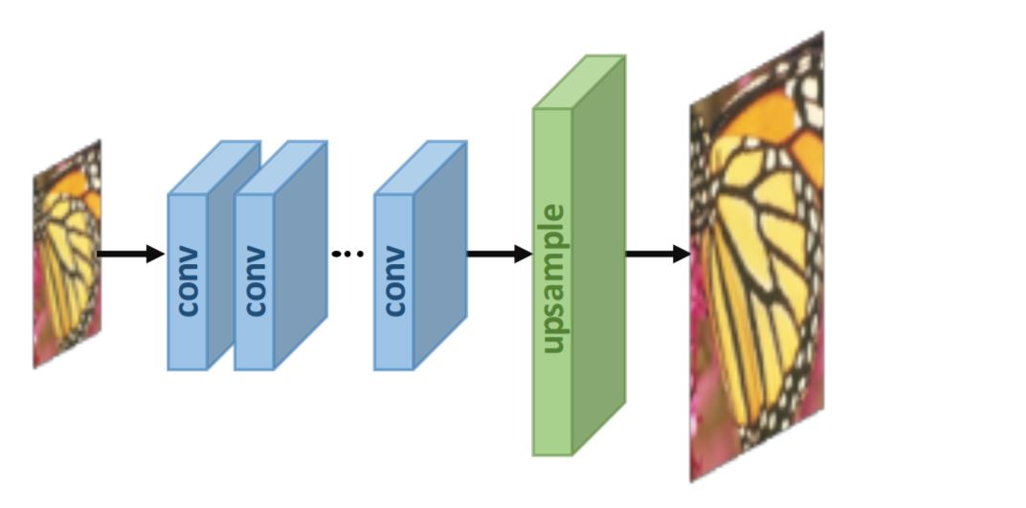
Results and simulations
There are two main types of image quality assessment (IQA) techniques: those that rely on human perception (how realistic the image appears) and those that rely on computation.

Slide 10
Reference
[1] H. Greenspan, “Super-resolution in medical imaging,” The Computer Journal, vol. 52, 2008.
[2] J. S. Isaac and R. Kulkarni, “Super-resolution techniques for medical image processing,” in ICTSD, 2015.
[3] Y. Huang, L. Shao, and A. F. Frangi, “Simultaneous super-resolution and cross-modality synthesis of 3d medical images
using weakly-supervised joint convolutional sparse coding,” inCVPR, 2017.
[4] L. Zhang, H. Zhang, H. Shen, and P. Li, “A super-resolution reconstruction algorithm for surveillance images,” Elsevier Signal

